Slide 1
Energy Conversion and Efficiency
in Hydropower, Natural Gas and Fossil Fuel, Wind Power, Nuclear and Solar Power
GROUP 1
By Raghav Agarwal, Gerald Mace, Tyler Heinrich,
Michael Wolak and Nate Crispel

Slide 2
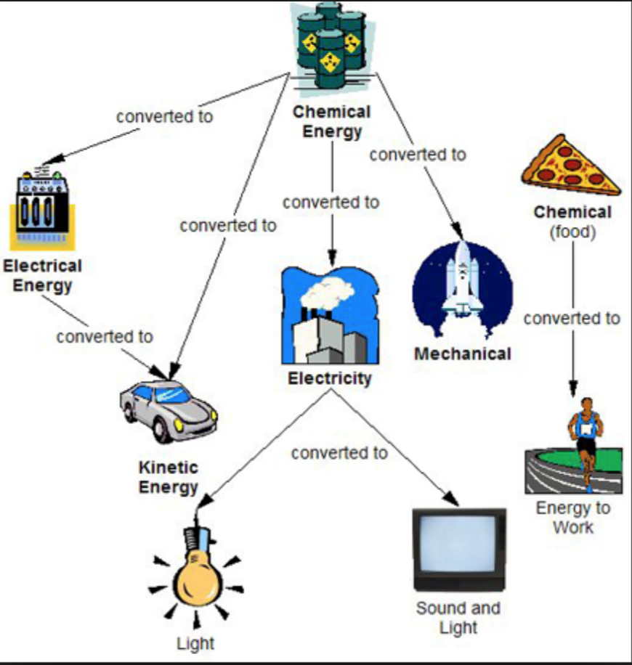
Overview
Introduction
Conversion between forms of energy
Fossil Fuels
Hydro Electricity
Nuclear Energy
Solar Power
Wind
References

Slide 3
Introduction
When considering the feasibility of Finite and Renewable sources of energy, one must consider the efficiency of the generation, conversion, and transportation processes that get that power to the user.
Depending on the energy source and its specific processes of generation and conversion, its efficiency can decide whether or not it is a truly feasible solution.
Research into increased efficiency of these processes will get society one step closer to energy sustainability.

Slide 4
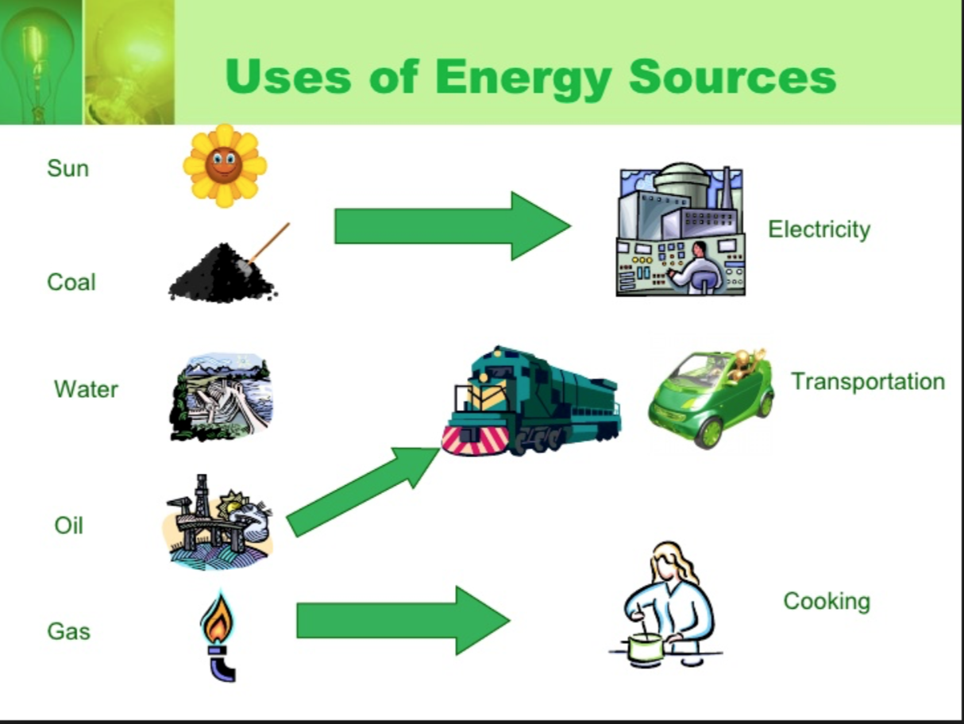
Conversions Between Forms of Energy
Energy Conversion: Is a change from one form of energy to another.
Most forms of energy can be converted into other forms.
Ex: Lamp and clock convert electrical energy into electromagnetic.
A water heater converts chemical energy in natural gas to thermal energy

Slide 5
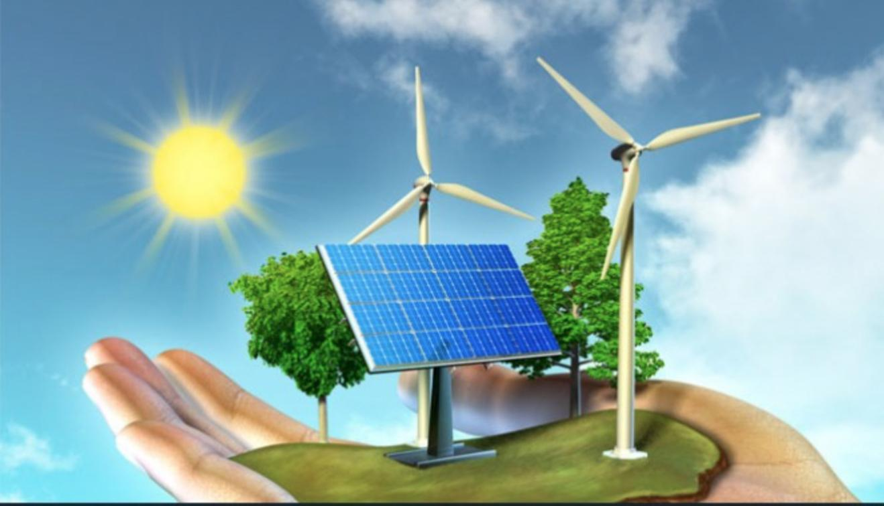
Energy Conservation
It means saving energy, or not wasting it.
This means that we should not waste fuels,
such as gasoline, or our resources will be used
up quickly.

Slide 6
Motivation
In today's world, most of the energy we use comes from fossil fuel plants while a small portion is being provided through renewables. These fossil fuel plants have very low efficiencies with materials that are slowly running out. In the long run this is in fact not sustainable for life after the next few decades.
One of the most important aspects of sustainability is studying the efficiencies of current day energy conversion systems and exploring how we can improve in the future. Without the study of these efficiencies, energy is essentially being wasted away as heat and pollutants that are harmful to our environment.
With a better understanding of the different energy systems and their conversion efficiencies, we can move forward in a beneficial way.

Slide 7
In this powerpoint presentation our group explores and explains the different energy conversions and efficiencies for the energy produced for six different renewable source of energy.
The renewables analysed are:-
Fossil Fuels
Hydro Power plants
Nuclear Energy
Solar Power
Wind Energy

Slide 8
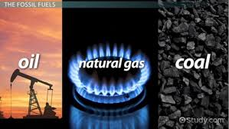
Fossil Fuels
The three types of Fossil Fuels used for energy purposes are
Coal - compacted land vegetation over millions of years; very abundant
Natural Gas - hydrocarbons like methane that formed over time underground
Oil - deposits of naturally occurring organic compounds trapped in sediment

Slide 9
Three Processes of Energy Generation
(The three types of fossil fuels use the same processes)
Conventional Steam: Oil/Coal/Natural Gas is burned to heat water to create steam to generate electricity
Combustion Turbine: Oil/Coal/Natural Gas is burned under pressure to produce hot exhaust gases which spin a turbine to generate electricity.
Combined Cycle: A combustion turbine uses heated exhaust gases to generate electricity. After these exhaust gases are recovered, water is heated in a boiler creating steam to drive a second turbine.

Slide 10
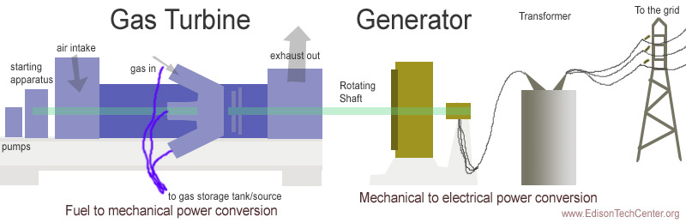
Energy Conversion
As described in the generation processes, the combustion creates thermal energy which powers turbines to create mechanical energy to power a generator to convert into electrical energy.
(simplified process diagram)

Slide 11
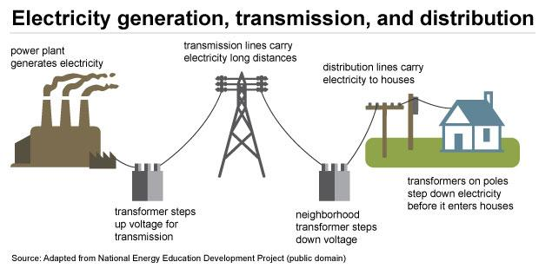
Transporting Electrical Energy
The process of transportation of the electrical energy doesn’t differ between sources of energy (Hydro, Nuclear, etc.) but this image is specific to fossil fuels

Slide 12
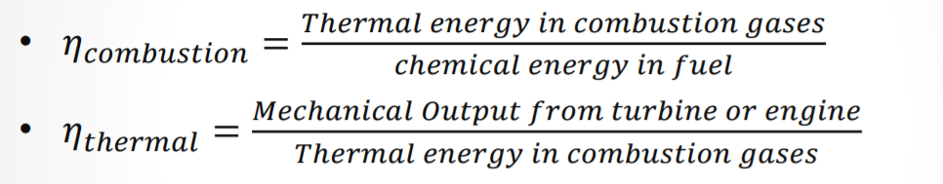
Efficiency at the Combustion Site
The two most important process to look at when determining the efficiency of fossil fuel energy generation, is with the combustion of the fuel and the thermal energy converting into mechanical energy.
(This image is taken from the lecture slides in class.)

Slide 13
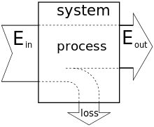
Efficiency Losses
The losses in fossil fuel efficiency come from Heat released, inefficiency in energy conversion to electrical, and its transfer from the power plant to the destination.
E-out (Useful output) / E-in (Input) = Efficiency

Slide 14
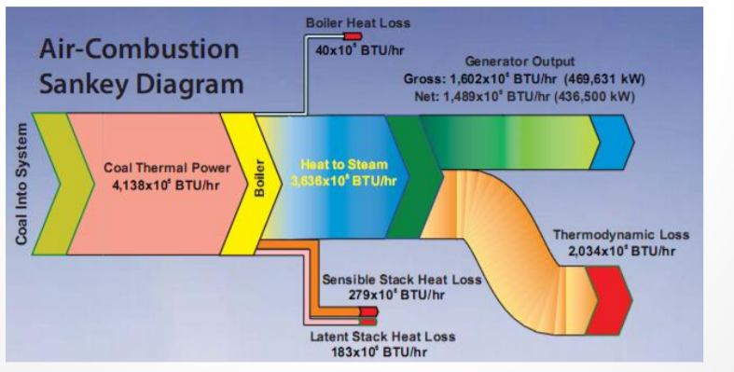
Thermal Losses
A large amount of thermal energy is lost in the initial combustion cycle. An obvious answer to improving efficiency would be to refine this process further.
(An example of heat loss and actual output of a coal combustion cycle.)

Slide 15
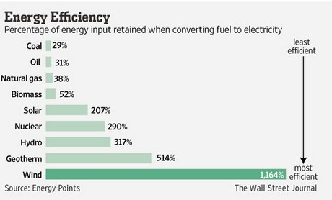
Fossil Fuel Summary
While they are finite and the least efficient energy source when converting to electricity, fossil fuels are currently abundant and will at least last us a couple more generations with current technology.
This graph considers the energy required to mitigate harmful effects of CO2 emissions in the energy efficiency of the fossil fuels.

Slide 16
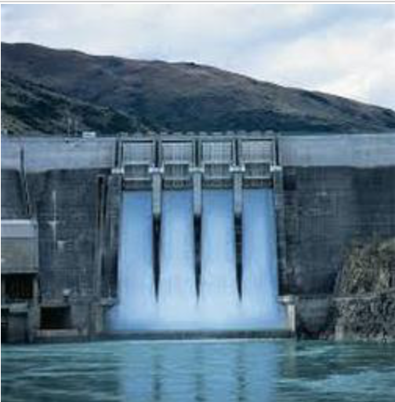
What is hydropower?
Hydropower is the renewable energy contained in flowing water. Electricity is generated using hydropower known as hydroelectricity and is generally considered to be reliable.
Hydroelectricity is the production of electric power through the use of the gravitational force of falling and flowing water.

Slide 17
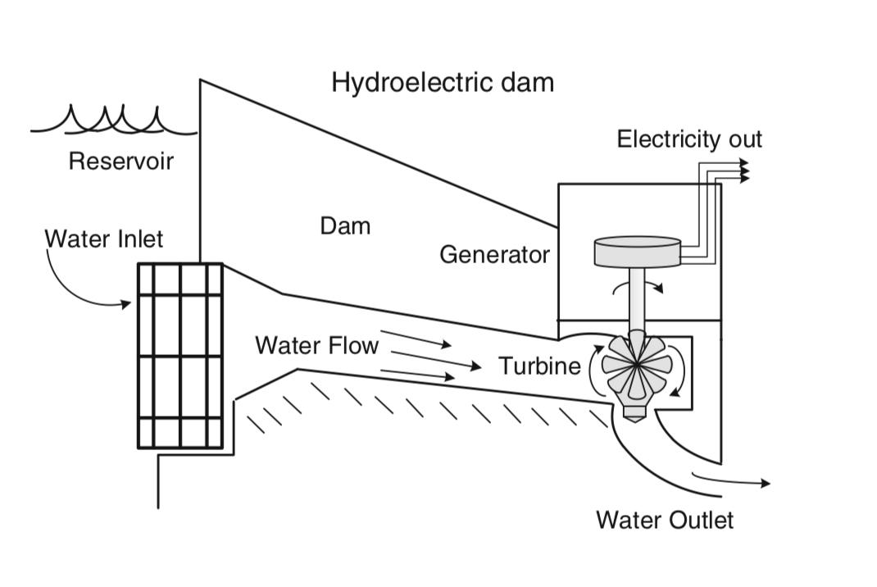
The figure shows a schematic of a conventional hydroelectric dam. The hydroelectric power is generated due to the potential energy of the dammed water driving the turbine and the generator.The amount of power extracted from the falling water depends on the volume of the water and the difference in height between the source and water’s outflow.

Slide 18
How is hydroelectricity generated?
Damming the water body converts its kinetic energy into potential energy- the reservoir resembles a battery which stores energy and the energy can be released when needed.
The reservoir’s potential energy is converted back into kinetic energy by opening the underwater gates in the dam.
As the gates open, the water flows through the a channel called the penstock towards the turbine.
The running water passing through the penstock rotates the blades of the turbine causing it to spin, converting some of water’s kinetic energy into mechanical energy.

Slide 19
The water then flows out of the dam and continue its journey downstream.
The turbine is connected to a generator through a shaft, so generator also spins as the turbine starts spinning.
The generator uses an electromagnetic field to convert this mechanical energy into electrical energy.
The turbine and generator are located in the dam’s powerhouse which also houses a transformer.
The transformer then converts the electrical energy to a high voltage.
This high voltage current is transmitted efficiently through power lines by the National Grid to the homes and businesses that need it.

Slide 20
Kinetic energy in falling water
Turning of the blades of the turbine
Generator in turn rotates due to the shaft connected from the turbine
Transformer produces high voltage
The potential energy stored in the water is converted into kinetic energy as it flows through the penstock into the turbine.
The turning of blades of the turbine converts the kinetic energy from water into the mechanical energy.
The generator uses an electromagnetic field to convert the mechanical energy into electrical energy.
The high voltage electric current is then transmitted by the power grid.
Main energy conversion steps in an hydroelectric power plant

Slide 21
Hydraulic Head
Hydraulic head measures the amount of mechanical energy available in the water.Hydraulic head is a measurement of the height of a static water column above a reference point.
The amount of energy harnessed in a hydroelectricity facility depends on the difference between the headwater level in the reservoir upstream of the dam and the tailwater level below the hydroelectric dam. This is known as the hydraulic head difference and it represents the amount of energy that can be transformed into electricity by the turbines and generators.

Slide 22
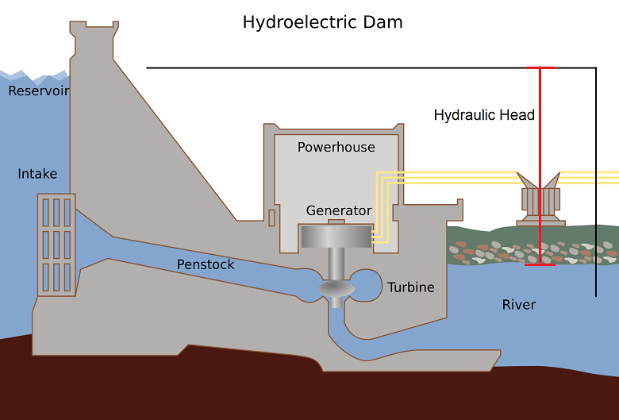
A hydroelectric plant showing the hydraulic head

Slide 23
The hydraulic head can be used to determine the power generated by a hydroelectric plant. The power generated is given by the following relation -
P=ρQgΔh
where
P = power generated ρ= density of fluid
Q = volumetric flow rate of fluid(in m³/s) g = acceleration due to gravity
Δh = hydraulic head difference

Slide 24
Based on the hydraulic heads the dams can be classified into three main types :-
High Head
Head difference of 100 metres or higher are considered as high head.
Water travelling through the turbine comes from a higher elevation. So the system needs a smaller volume of water to produce an equivalent amount of energy.
High head plants require smaller turbines since less water is flowing through the turbine.
High head plants have longer penstock to guide the water travelling down from high elevation reservoir.

Slide 25
2) Medium Head
Head differences between 10 and 100 metres.
Penstock is slightly shorter as compared to high head because there is less elevation drop.
3) Low Head
Head differences of around 10 metres or less.
Generally used in facilities such as run-of-the-river systems where there is a flowing river with little elevation change.
Transport large volumes of water and require larger turbines to produce electricity.

Slide 26
Head Losses
Energy is lost due to friction as water flows through the pipes and this results in lower power production. This loss results in the decrease of overall head.
Two types of head losses
Minor head loss - Arises from any other place besides friction in the pipes. Minor losses are occur due to pipe bends or changes in the velocity of water flow.
Major head loss - Major head losses arise mainly from friction in the pipes, and occur over long lengths of pipe, such as in the penstock.

Slide 27
Types of turbine (based on the principle of operation)
Impulse turbine - Driven by high velocity jets of water
Reaction turbine - The rotor is fully immersed in water and is enclosed in a pressure casing and pressure differences across the runner blades impose lift forces on the blade.
Gravity turbine - Driven by the weight of the water entering the turbine.

Slide 28
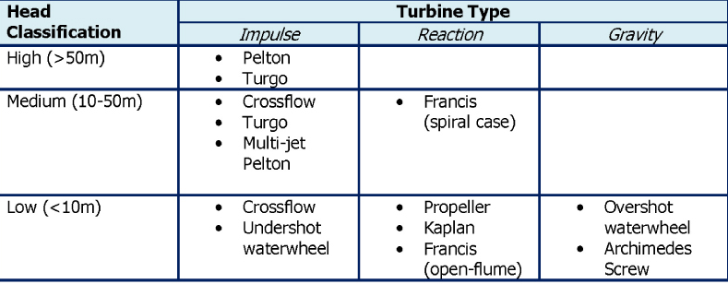
Turbine Classification

Slide 29
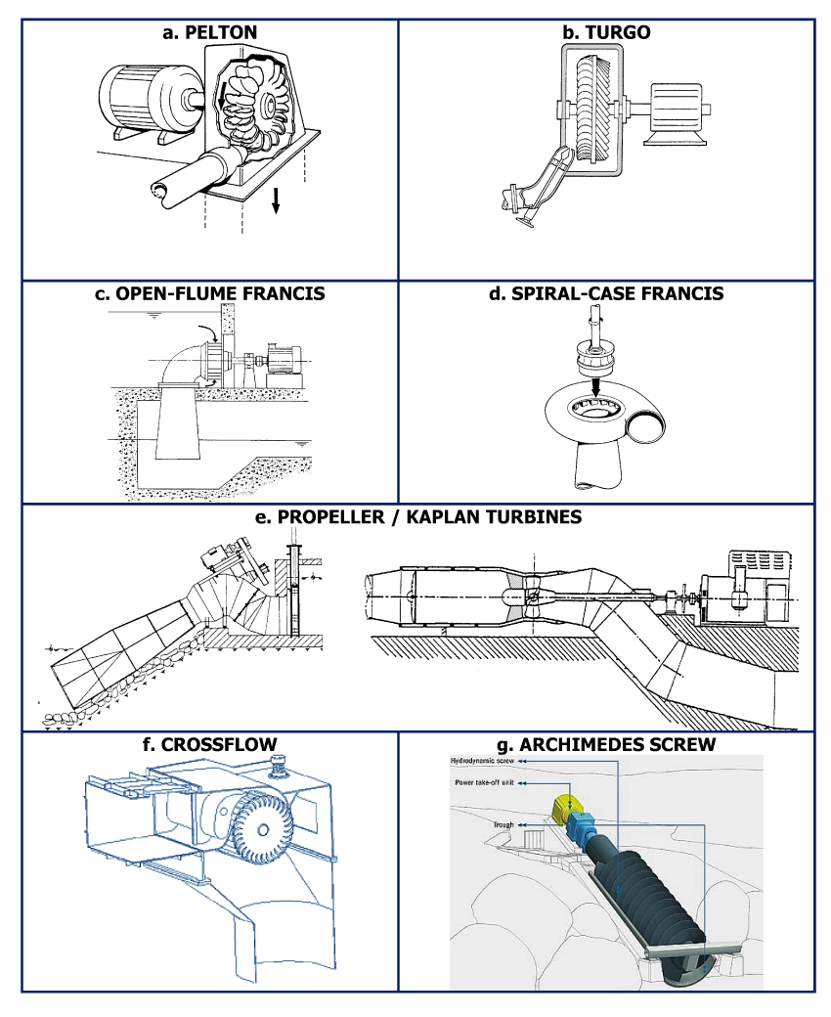
Schematic of different types of turbines used in a hydroelectric power plant.

Slide 30
Pelton Wheel
Its a type of an impulse turbine which has one or more free jets discharging water into an aerated space and impinging on the buckets of a runner. Draft tubes are not required for impulse turbine since the runner must be located above the maximum tailwater to permit operation at atmospheric pressure.
Cross flow
A cross-flow turbine is drum-shaped and uses an elongated, rectangular-section nozzle directed against curved vanes on a cylindrically shaped runner.The cross-flow turbine allows the water to flow through the blades twice. A guide vane at the entrance to the turbine directs the flow to a limited portion of the runner. The cross-flow was developed to accommodate larger water flows and lower heads than the Pelton.

Slide 31
Propeller Turbine
These turbines have 3 to 6 blades and water contacts all of the blades constantly. For these turbines the pressure remains constant and the pitch can be altered. A set of inlet guide vanes admits the flow to the propeller and the vanes can be adjusted so as to allow the flow passing through the machine to vary.
Bulb Turbine
The turbine and generator are a sealed unit placed directly in the water stream.
Kaplan Turbine
Both the wicket gates and the blades are adjustable, allowing a wide range of operations.

Slide 32
How much electricity can a Hydroelectric Plant make?
The amount of electricity produced depends on two factors:
How far the water is falling- the farther the water falls, more is the power generated. The distance the water falls depends on the size of the dam.
Amount of water falling- More the amount of water falling on the turbine more is the power produced.

Slide 33
Generating Power
To generate electricity, water must be in motion(kinetic energy).
The falling water flowing through the penstock rotates the blade of the turbine and the form is changed to mechanical energy.
The turbine in turn rotates the generator rotor which then converts this mechanical energy to electrical energy.
The water after completing its task flows on unchanged to complete other tasks.

Slide 34
Transmitting Power
The electricity produced needs to be delivered to homes, schools, factories.
Since dams are located in remote areas,vast networks of transmission lines and facilities are used to bring electricity in a useful form.
The electricity produced by the hydroelectric power plant are stepped up(increase in voltage) by the transformer before transmitting the energy over large distances through power lines.
This high voltage current are stepped down(decrease in voltage) at local substations.
The supplied power is further reduced to the right voltage for the appliances and use at home by the transformer on poles .

Slide 35
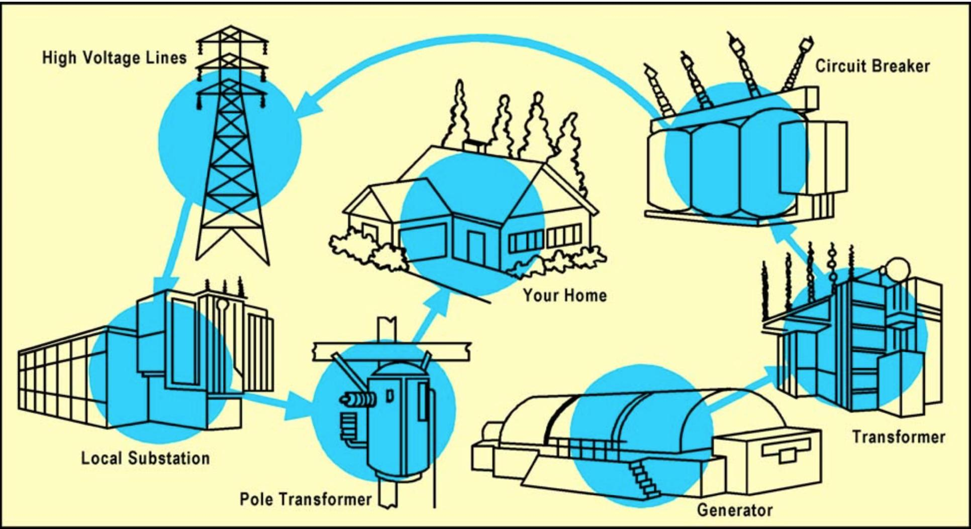
Schematic of transmission of electric power from a hydroelectric power plant to our homes.

Slide 36
Efficiency of a hydroelectric power plant
The efficiency of a hydro power plants depends primarily on the size of the dam Large hydro plants have higher efficiencies because large hydro plants have larger dams and better turbines installed as compared to small hydro power plants. Moreover the flow of water in a small hydro power plant is not consistent which results in lower efficiency.
Large Hydro Power Plant
Upto 95%
Small Hydro Power Plant
Upto 90%
The electrical efficiency of the hydroelectric power station depends mainly on the type of the water turbine and the size of the dam and reservoir.

Slide 37
Transmission and distribution efficiency of hydro electric power plants.
The electric power generated in the generator is stepped up by the transformer before being transmitted by the power grid over large distances.
Current being transmitted by the high-voltage lines is lost in the form of heat as the electrons moving back and forth, crash into each other thereby resulting in collisions which warm up power lines and the air around them.
Total energy lost in transmission and distribution is about 6%-2% in transmission and 4% in distribution( mainly heat losses through the wires due to friction and resistance) - or 69 trillion Btus in the United States in 2013.

Slide 38
Summary
Hydropower should be encouraged as it is one of the cleanest and cheapest as well as reliable source of energy.
Hydropower plants do not generate any greenhouse gases.
Hydropower plants ensure steady and regular production of electricity as compared to other renewables like solar and wind energy.
The reservoir that forms as a result of building hydroelectric power plant isn't only used for generating electricity but can also be used for irrigation and recreational tourism in form of water sports, fishing, swimming, and boating.

Slide 39
Nuclear Power
What is Nuclear Power?
Energy generated through harnessing nuclear fission
What is Nuclear Fission?
A nuclear chain reaction in which a nucleus splits and its components initiate the splitting of nearby nuclei
How does the power plant work?

Slide 40
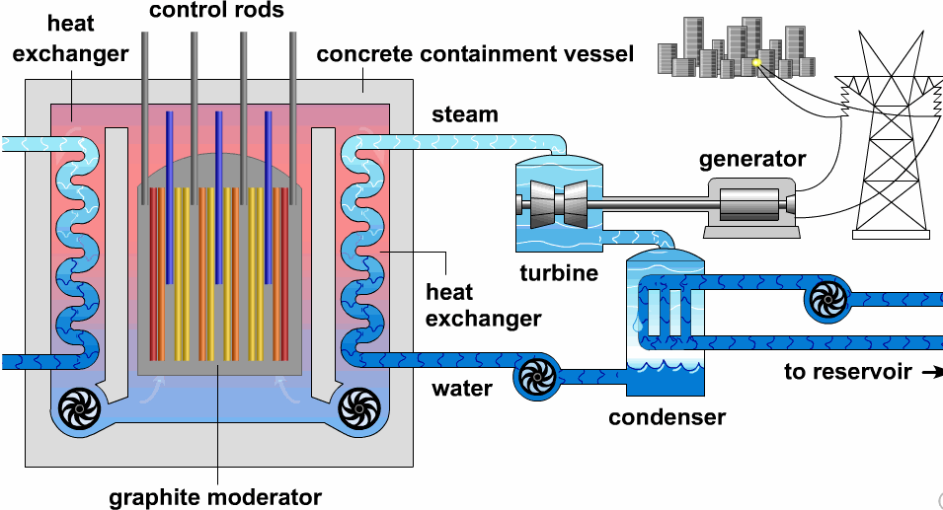

Slide 41
Nuclear Power Plant
Nuclear Reactor
Houses fuel
Where Fission occurs and water is heated
Steam Generator
Heat transfer creates steam and is directed towards turbine
Turbine
Steam drives turbine, similar to a steam engine
Turbine spins and drives an electromagnet
Generates electricity

Slide 42
Nuclear Reactor and Nuclear Fission
Fuel Rods
Holds radioactive isotopes
Initiate and continue nuclear fission
Moderator- slows nuclei
75% light water
20% solid graphite
5% heavy water (hydrogen replaced by deuterium)
Regulates the speed of nuclei
Control Rods- attracts nuclei
Regulates the amount of nuclei in reaction

Slide 43
Fuel: Uranium-235
Details
2nd most common Isotope of uranium
Used in power plants and nuclear weapons
Commonality
0.75% of all naturally occuring uranium
Energy Density
79,390,000 MJ/kg

Slide 44
Fuel: Uranium-238/Plutonium-239
Details
U-238 is non-fissionable
Made into Pu-239 inside a reactor
Addition of neutron
Emission of electron and anti-neutrino
Commonality
U-238 is the most common uranium isotope
Energy Density
80,620,000 MJ/kg

Slide 45
Fuel: Thorium-232/Uranium-233
Details
Th-232 is non-fissionable
Made to Made into U-233 inside a reactor
Capture-to-fission ratio is smaller than U-238 to Pu-239
Has been used experimentally, weaponry and molten salt reactors
Commonality
Most common isotope of Thorium
Energy Density
79,420,000 MJ/kg

Slide 46
Types of Nuclear Power Plants - 448 total NPP
Boiling Water Reactor (BWR)
75 world-wide
Pressurized Water Reactor (PWR)
292 world-wide
Pressurized Heavy Water Reactor (PHWR)
49 world-wide
Gas-Cooled Reactor
14 world-wide
Light Water Graphite Reactor
15 world-wide
Fast Neutron Reactor (FBR)
3 world-wide

Slide 47
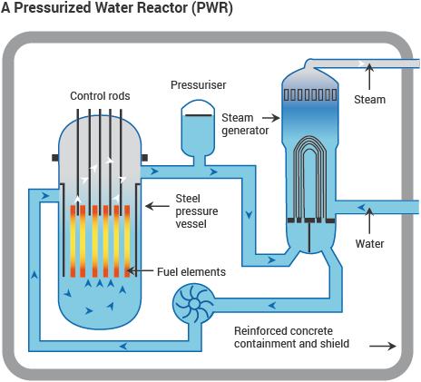
Pressurized Water Reactor (PWR)
Water kept from boiling at 325 degrees Centigrade with 150 atm
292 used globally by US, France, Japan, Russia, China
Generates 275,000 MWe per year
Water cooled and moderated
Fueled by 80-100 tonnes of Uranium in 200-300 fuel rods
Originally designed as a submarine reactor
Efficiency of ~ 33%

Slide 48
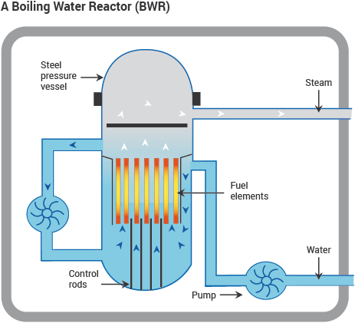
Boiling Water Reactor (BWR)
Similar to PWR, but with single water circuit at low pressure
Water boils in core at 285 degrees Centigrade
75 used globally by US, Japan and Sweden
Generates 73,000 MWe per year
Water cooled and moderated
Fueled by 140 tonnes of Uranium in 90-100 fuel rods
Has less water in top of reactor chamber, with lower moderation and lower efficiency ~30%

Slide 49
Fast Neutron Reactor (FNR)
Used by Russia
Does not use a moderator, has fast reactions
Generates power from Pu-239 while generating U-238 in or around the fuel
Generates 1400 MWe per year
Gets 60x more energy than normal reactors do with original uranium
Expensive to build
Fueled by Pu-239
Potential for much more efficient use of uranium
Called “Fast Breeder Reactor” if more Pu-239 is produced than used

Slide 50
Nuclear Reactor Efficiencies
Power Plant Type
PWR is most efficient
Great potential for increased efficiency in FNR or FBR
Could produce more fuel than it uses
Uses uranium efficiently
Fuel Type
Uranium 238/ Plutonium 239 has the greatest energy density
Is most efficient (FNR/ FBR)
Problems with improving efficiency
Power plants are designed to operate differently, PWR and BWR have different configurations.
It generally costs more to build a more complex and efficient power plant

Slide 51
Nuclear Power - Summary
Characterized by a extraordinarily high energy density
Fuel is difficult and expensive to develop
Efficiencies range around 30%
Future improvements can be made with Fast Neutron Reactors and Fast Breeder Reactors to improve efficiency
Uranium is a limited resource

Slide 52
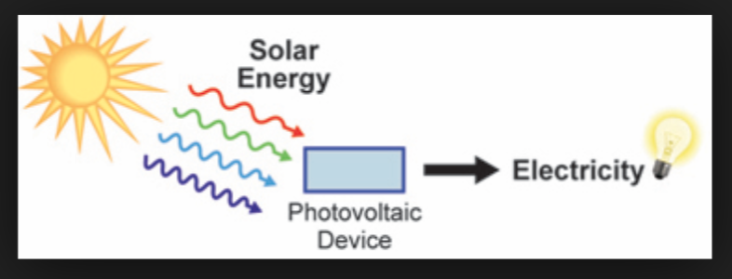
Solar Energy
Solar to Electricity - Photovoltaic
Traditional PV Solar Panels
Solar to Thermal
Concentrated Solar Power
Solar water heating

Slide 53
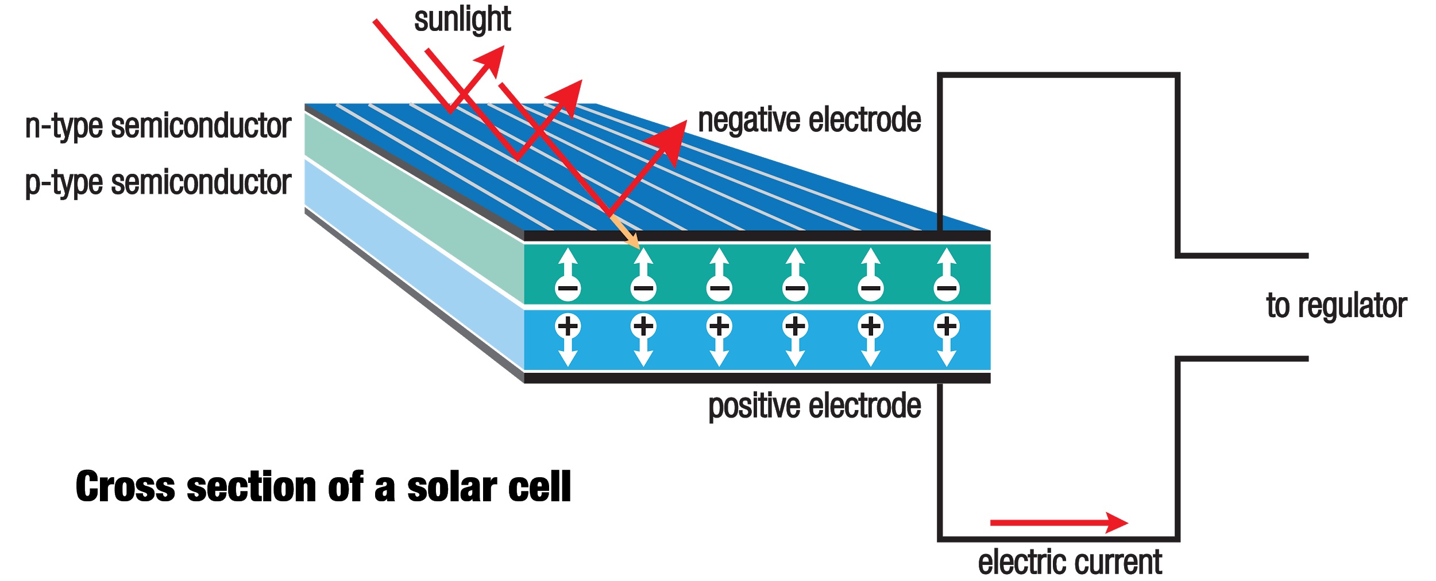
Photovoltaics - How they work
http://2oqz471sa19h3vbwa53m33yj.wpengine.netdna-cdn.com/wp-content/uploads/2017/01/solar_cell.png

Slide 54
Photovoltaics - How they work
The two layers of semiconductors, often silicon, are “doped” with materials that give them opposing charges. This creates an electric field at the junction between the layers.
When photons hit atoms in the upper layer, they knock electrons free. These electrons flow through the electric field and are captured to generate useful electric current.
Researchers have been developing progressively thinner cells, as thin as 1.3 microns.
https://www.livescience.com/41995-how-do-solar-panels-work.html

Slide 55
Photovoltaics - How they work
Infographic on Photovoltaic energy conversion http://2oqz471sa19h3vbwa53m33yj.wpengine.netdna-cdn.com/wp-content/uploads/2017/01/solar-panels-animation.gif

Slide 56
Photovoltaic - Conversion Efficiency
Factors affecting efficiency
Wavelength of light
Only some have correct energy to be converted by PV cell
Recombination
Absence of electron and electron cancel and cancel out
Temperature
Better at low temp
High temp changes semiconductor properties and can damage cell
Reflection
Treat surface to reduce reflected light
High efficiency cells appear dark blue or black
https://www.energy.gov/eere/solar/articles/solar-performance-and-efficiency

Slide 57
Photovoltaic - Conversion Efficiency
Solar Cell efficiency is defined as the maximum theoretical power output over the power input from the sun.
The maximum theoretical efficiency for single-junction PV is around 33%, as defined by the Shockley-Queisser limit.
The most efficient panel, in a lab setting, has a nearly 29% conversion efficiency, and is made using crystalline gallium arsenide.
The most efficient commercial product on the market currently, according to energysage.com, is produced by SunPower, and has a 22.2% conversion efficiency.
https://news.energysage.com/what-are-the-most-efficient-solar-panels-on-the-market/
https://www.greentechmedia.com/articles/read/a-new-efficiency-world-record-for-a-perovskite-solar-cell-can-oxford-pv-hit#gs.FvTaYJs

Slide 58
Concentrated Solar Power - Molten Salt
Source - https://www.solarreserve.com/en/technology/molten-salt-energy-storage
Solar energy focused on receiver
Salt flows through piping in receiver
Heated to 566⁰ C and stored at this temp.
When electricity is needed salt is dispatched to heat exchanger to heat steam for turbine
Salt never needs replacing for the 30+ year lifetime of the plant
Heat loss only 1F a day
Salt environmentally friendly and non-toxic

Slide 59
Concentrated Solar Power - Molten Salt
Source - https://www.solarreserve.com/en/technology/molten-salt-energy-storage
Molten Salt is used to heat steam to temperatures that can be used in steam turbine power plants
This capability is 24/7, so it can be used to make up for the inconsistency of solar energy availability.

Slide 60
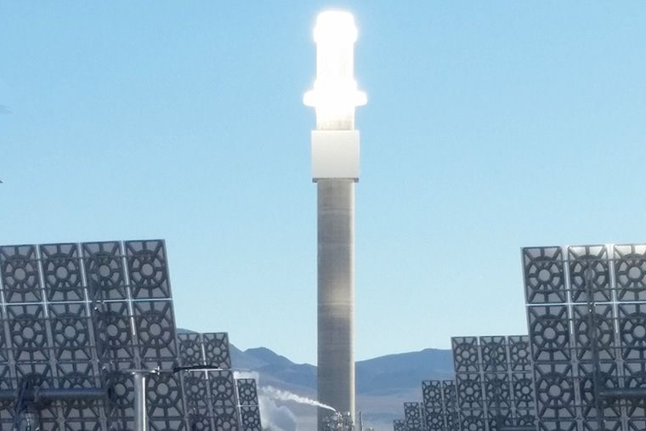
Picture of tower

Slide 61
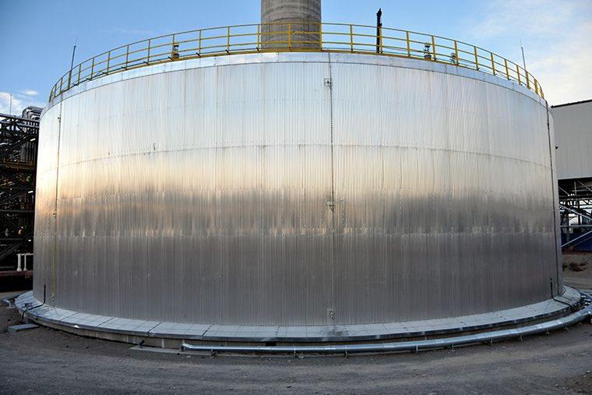
Picture of Storage Tank

Slide 62
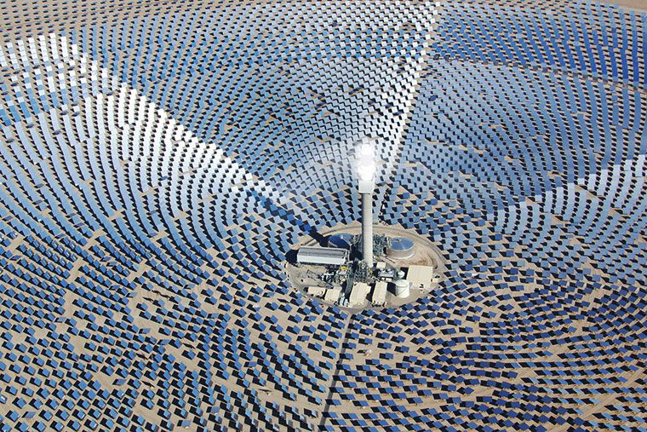
Picture of Array

Slide 63
Concentrated Solar Power - Molten Salt
Advantages
Operates like conventional power plants
Uses same energy conversion tech for turbine
Generates electricity when needed
No fuel costs
Greater net annual output than other solar tech
Crescent Dunes Solar Energy Facility in Nevada
110 MW output with 500,000 MW-hours a year production
Total land area 1600 acres or 6.47x10^6 m^2
Energy density is 16.99 W/m^2
https://www.power-technology.com/projects/crescent-dunes-solar-energy-project-nevada/ https://www.solarreserve.com/en/technology/molten-salt-energy-storage

Slide 64
Concentrated Solar Power - Parabolic Trough
https://www.seia.org/initiatives/concentrating-solar-power
Curved mirrors to concentrate energy on receiver tube
Heat transfer fluid in tube gets to 750F+ and is used to heat and boil water

Slide 65
Concentrated Solar Power - Compact Linear Fresnel Reflector
Same principle as parabolic
Flat mirrors in rows to concentrate sunlight on water tubes
Water boils and generates steam
Steam used for industrial applications and power generation

Slide 66
Domestic Solar Water Heaters
Direct circulation systems
Pumps circulate water through collectors into home
Indirect circulation systems
Heat transfer fluid through pipes that then heats water
https://www.energy.gov/energysaver/water-heating/solar-water-heaters

Slide 67
Domestic Solar Water Heaters
Flat Plate collector
Integral collector-storage systems
Evacuated-tube solar collectors
https://www.energy.gov/energysaver/water-heating/solar-water-heaters

Slide 68
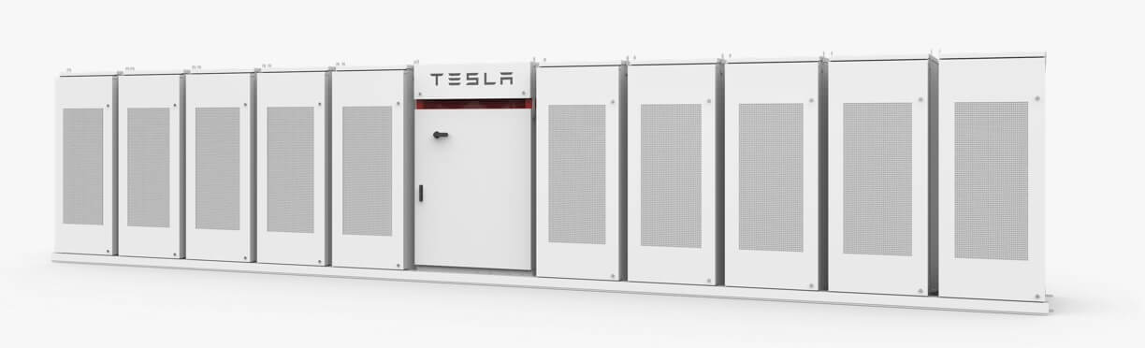
Storage Methods
Molten Salt Storage discussed above is a form of thermal storage
Batteries can be used to store large amounts of energy.
Tesla’s Powerpack system can be used at a grid scale to help increase reliability of intermittent energy solutions like solar and wind.
https://www.energy.gov/energysaver/water-heating/solar-water-heaters https://www.tesla.com/powerpack

Slide 69
Solar Summarized
Solar Energy is the most plentiful form of energy available on the planet, but our conversion methods are currently lacking.
To begin to be truly relient on solar power for electricity, we must increase the efficiency of conversion methods and improve our storage options.
There are great advances being made in all forms of solar energy conversion, so the future is promising.

Slide 70
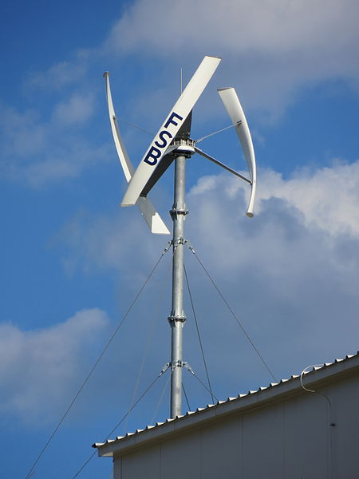
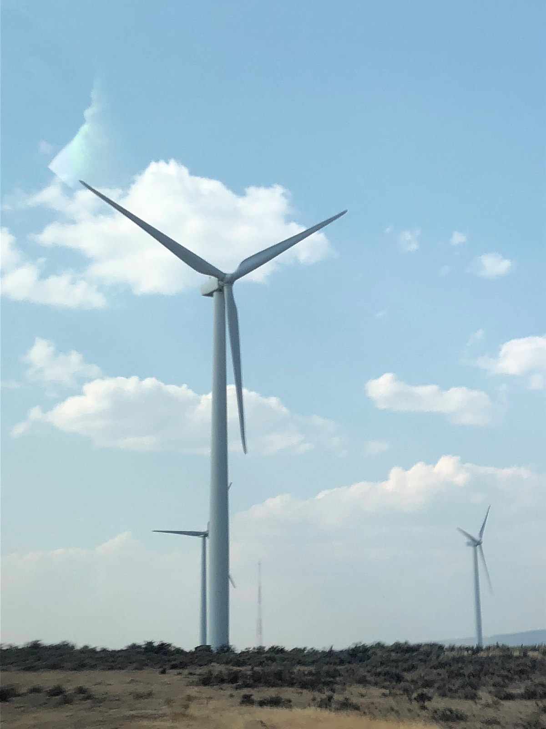
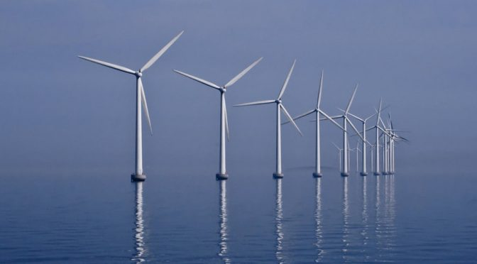
Using Wind Power for Energy Conversion
http://blogs.worldwatch.org/wp-content/uploads/2016/11/Flickr-middelgrunden-wind-farm-Denmark-672x372.jpg
https://upload.wikimedia.org/wikipedia/commons/thumb/0/08/Wind_turbine_FSB_Zagreb_20130513_0424.JPG/450px-Wind_turbine_FSB_Zagreb_20130513_0424.JPG
https://upload.wikimedia.org/wikipedia/commons/thumb/7/7b/Central_Washington_wind_turbine.jpg/1200px-Central_Washington_wind_turbine.jpg

Slide 71
What is wind power?
Extracting energy from naturally occurring air currents and converting it into useful electrical energy that can be used in the power grid.
Clean and sustainable
Renewable energy source
Natural temperature differences cause air currents

Slide 72
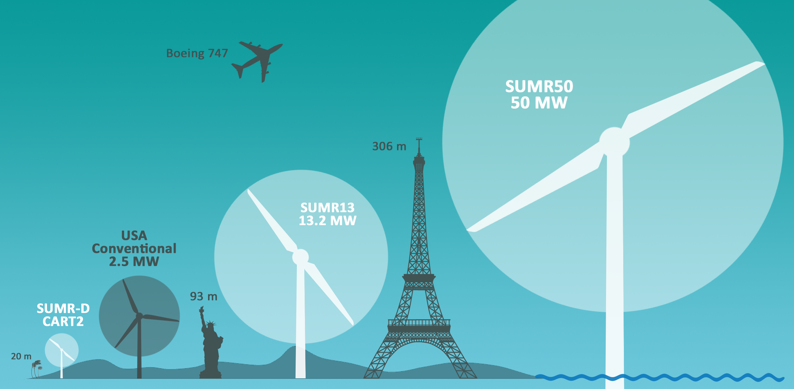
Wind turbines come in different shapes and sizes
Vertical Axis
Horizontal Axis
Land
Off-Shore
Small scale vs large scale
https://www.scientificamerican.com/article/world-rsquo-s-largest-wind-turbine-would-be-taller-than-the-empire-state-building/

Slide 73
Vertical vs. Horizontal Axis Turbines
Vertical Axis:
Driveshaft is vertical, or perpendicular to ground
Low space constraint
Small scale application such as residential use
Fin design:
Can operate in wind conditions coming from all 360 degrees, as well as wind drifts from low altitude to high altitude
This is a large advantage when dealing with turbulent and unpredictable wind
Horizontal Axis:
Driveshaft is horizontal, or parallel with the ground
Needs large amounts of space
Best for big wind applications
Will produce the most energy with less wind
More efficient
Need more steady, non turbulent wind

Slide 74
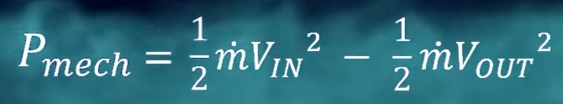
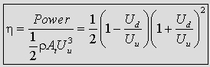
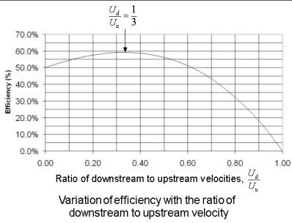
Wind Turbine Efficiency Limit
Total Wind Energy to Mechanical Energy can only be so high due to the nature of air flow.
This energy gained through the turbines fins can be measured by taking the velocity of wind flow going into the fins vs the velocity after the fins.
Betz’s Limit = 59.3% Efficiency
Wind turbines theoretically can not exceed 59.3% mechanical efficiency
Bentz theory is based on conservation of momentum and Bernoulli’s fluid equations
After derivation, an efficiency equation is found:
Using Different upstream-downstream ratios and creating a graph it is obvious that the peak efficiency lies at 59%
https://www.youtube.com/watch?v=qSWm_nprfqE

Slide 75
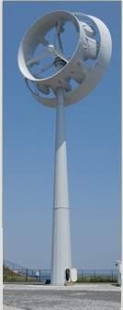
Betz’s Limit Continued
Can the limit be exceeded
Ultimately it is only a theory
There is possibility to exceed this limit in the future
Currently there have been experiments using a type of shroud around fins in order to create a low pressure pocket on the downstream end forcing more air to be transferred through
However this could prove to be difficult to implement on large scale turbines due to shear size. There is also little data to back up this possible innovation
Betz limit applicable only for horizontal axis wind turbines.
No theory has been provided for vertical axis turbines yet, however it is known that generally the efficiency is lower on these than that of the horizontal axis turbines.
We do know that a wind turbine couldn't possibly transfer 100% of the wind energy into mechanical energy. That would mean the downstream air wouldn't be moving. If the air downstream wasn't moving, there would be no air to pass through the turbine, causing the spin to stop.

Slide 76
Wind Turbine Design for High Efficiency
Blades:
Each blade or “fin” acts as a wrench providing torque to the center shaft. This means that the longer the blade, the greater the torque and the greater the energy produced. However, there is a point where the blades can be long enough that their tip angular velocity is large enough that it puts more stress on the mechanism and also reduces efficiency.
The number of blades comes down to cost and reliability.
Due to varying wind speeds at different altitudes, the force applied to the top blades would be greater than those of the bottom. Using an even number of blades would cause an imbalance of force on the center rotary shaft and cause much more wear on the gearbox.
Adding more blades would in fact result in more energy at lower wind speeds, but this increase is marginal and not worth the large cost associated with more blades.
An odd number of blades also does a much better job of controlling inertia due to yaw, thus again increasing reliability and life-time of blades.
Blades are constructed with a small twist and a taper along their length to provide optimal resistance to wind while also producing lift to keep the blades spinning at lower speeds.

Slide 77
General Energy Conversions
In the process of extracting energy from a wind turbine, there are a few energy conversions that take place before the energy enters the grid.
Kinetic energy from wind → Rotational mechanical energy
Rotation mechanical energy → Electrical DC energy
Electrical DC energy → Electrical AC energy

Slide 78
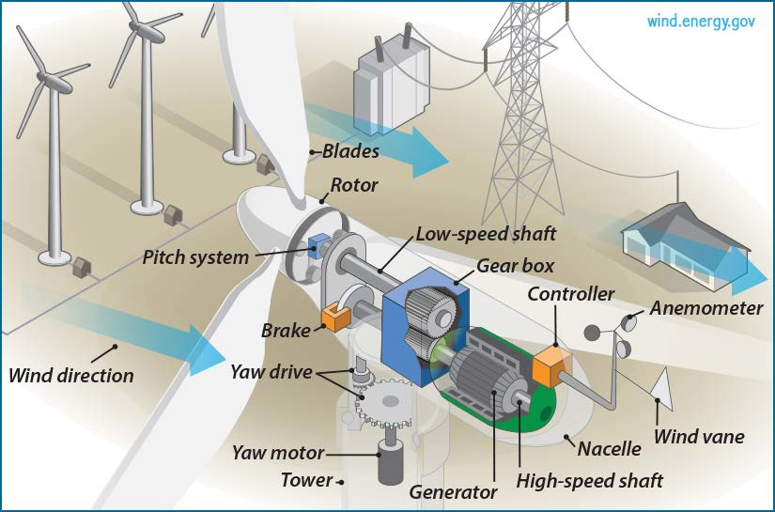
Wind Turbine Simple Schematic
https://www.researchgate.net/profile/Marcias_Martinez/publication/265382474/figure/fig1/AS:392207954661392@1470521071896/Wind-turbine-schematic-source-US-DOE.png

Slide 79
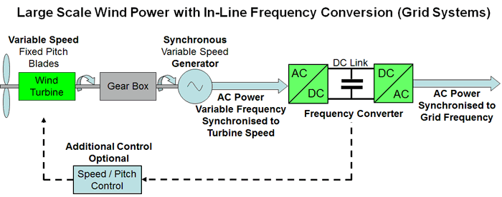
Energy Transfer Schematic
Example:
https://www.mpoweruk.com/images/synchronous_generator.gif
Kinetic Wind Energy
Rotating Mechanical Fins
Gearbox (~1:100)
Electric Generator
Transformer
Power Grid
n ~ 50%
Losses:
-Betz limit
-Failed energy capture
n ~ 95%
Losses:
-Gear slippage
-heat dissipation from friction
n ~ 80%
Losses:
-Electrical resistance
- Windage
-Bearings
Total n = (.5)(.95)(.8) = 38% Efficiency → Grid

Slide 80
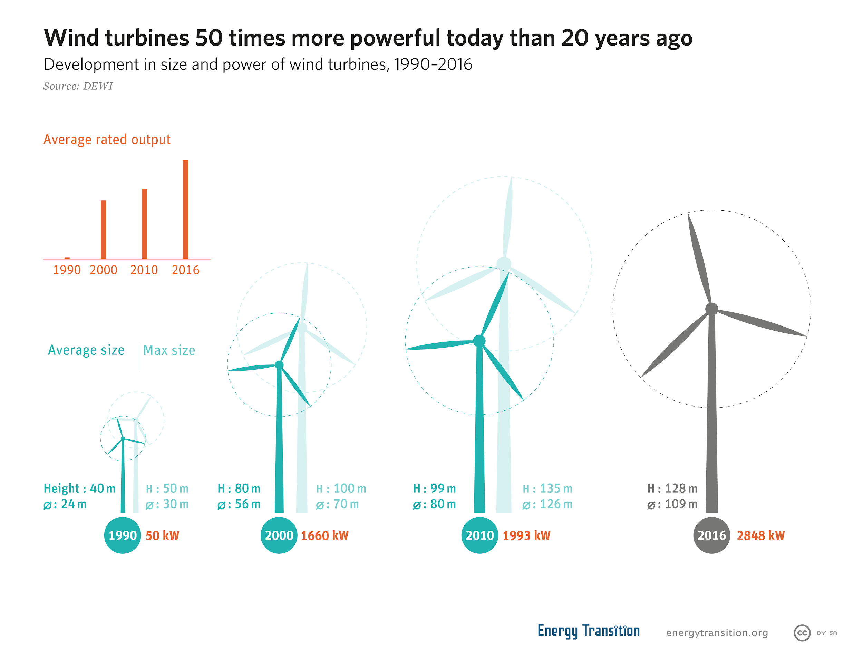
Wind Turbine Trends
Today, wind total efficiencies average at around 35-40%. The best models being just over 50%.
Wind turbines are continually getting larger, which means more power output per unit.
More controls being implemented to increase efficiency
Turbines need to be directly perpendicular to wind flow for optimal efficiency
https://book.energytransition.org/sites/default/files/GET_en_Wind%20turbines%2050%20times%20more%20powerful%20today%20than%2020%20years%20ago.png

Slide 81
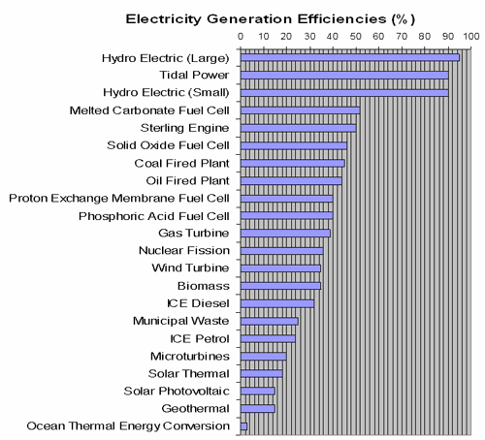
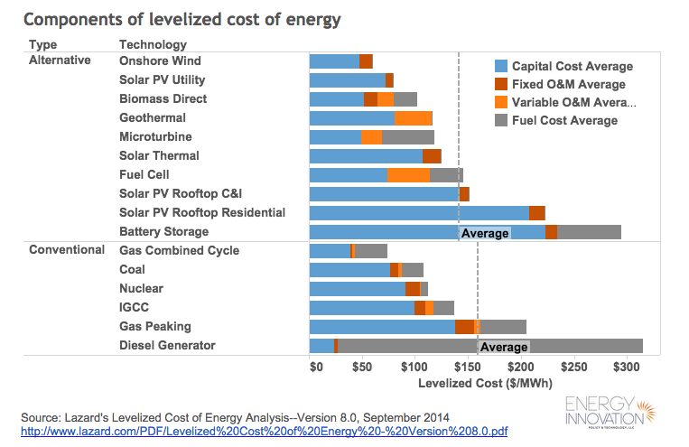
Wind Efficiency/Cost Comparatively
Wind is a competitive, affordable energy option compared to others
https://www.mpoweruk.com/images/efficiencies.gif

Slide 82
Downsides to Wind
As seen in previous slides, the size of wind turbines are very large and only getting bigger.
To have an effective wind field, very large areas of clear space are needed. These kinds of spaces are limited
Environmental effect
Although wind energy is clean, it can take away from landscapes and nature areas creating an “eye sore” to conservationists
Poses a threat to birds and other flying animals
Wind turbines put out a fair amount of noise
~40 dB at 300 meters away, where residential houses can be located
This can pose as a nuisance for those living near the turbines

Slide 83
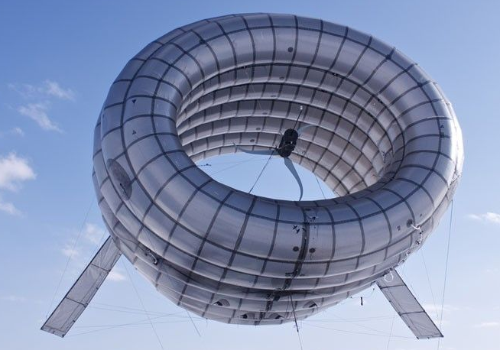
Other Wind Energy Machines and the Future
In the past, wind energy has not only been used for electricity but also as mechanical energy. These machines were known as windmills.
These windmills were used for farming purposes such as grinding down grain or acting as a pump for wells thus providing water to communities.
Looking toward the future, we can better optimize wind turbine models of the present while also looking into other interesting designs such as floating turbines, suspended by large helium filled disks for example.
https://www.treehugger.com/wind-technology/future-wind-power-9-cool-innovations.html

Slide 84
Wind Summarized
Even with some downsides to wind energy, it is an undeniably efficient and clean way to supply electrical power to the grid.
Looking toward the future to a better, more sustainable society, there is no doubt that we need to continue to utilize and innovate wind power. This will not only supply humanities energy needs, but will also eliminate a portion of CO2 saturation and make for a healthy, long lasting planet as well.
As with every other energy source, efficiency is of utmost importance and as a society we need to continue to strive to improve in this regard.

Slide 85
References
https://www.usbr.gov/power/edu/pamphlet.pdf
http://www.wvic.com/Content/Facts_About_Hydropower.cfm
https://www.netl.doe.gov/File%20Library/Research/Coal/energy%20systems/gasification/gasifipedia/EEGJulyrevisedFINAL1-2003-030-0548-2.pdf
http://insideenergy.org/2015/11/06/lost-in-transmission-how-much-electricity-disappears-between-a-power-plant-and-your-plug/
http://greenbugenergy.com/get-educated-knowledge/types-of-turbines#prettyPhoto
http://www.world-nuclear.org/information-library/nuclear-fuel-cycle/nuclear-power-reactors/nuclear-power-reactors.aspx
https://www.youtube.com/watch?v=1U6Nzcv9Vws
https://www.nuclear-power.net/neutron-moderator/
http://www.wind-power-program.com/betz.htm
http://www.alternative-energy-tutorials.com/wind-energy/wind-turbine-design.html

